Slide 1
ANALYSIS OF US CANDY DISTRIBUTOR SALES DATA
Presented by KUSUM TALREJA

Slide 2
Agenda
To make an interactive dashboard for data-driven decisions.
To make stakeholders understand their sales data.
To help the business make data driven decisions.

Slide 3
About the dataset
Region
Product ID
Product Name
Sales
Units
Gross profit
Cost
The dataset has multiple tables. I have selected the candy-sales table to work with.
The data contains:
Row ID
Order ID
Order and Ship Date
Ship Mode
Customer ID
Country
City
State/Province
Postal code
Division

Slide 4
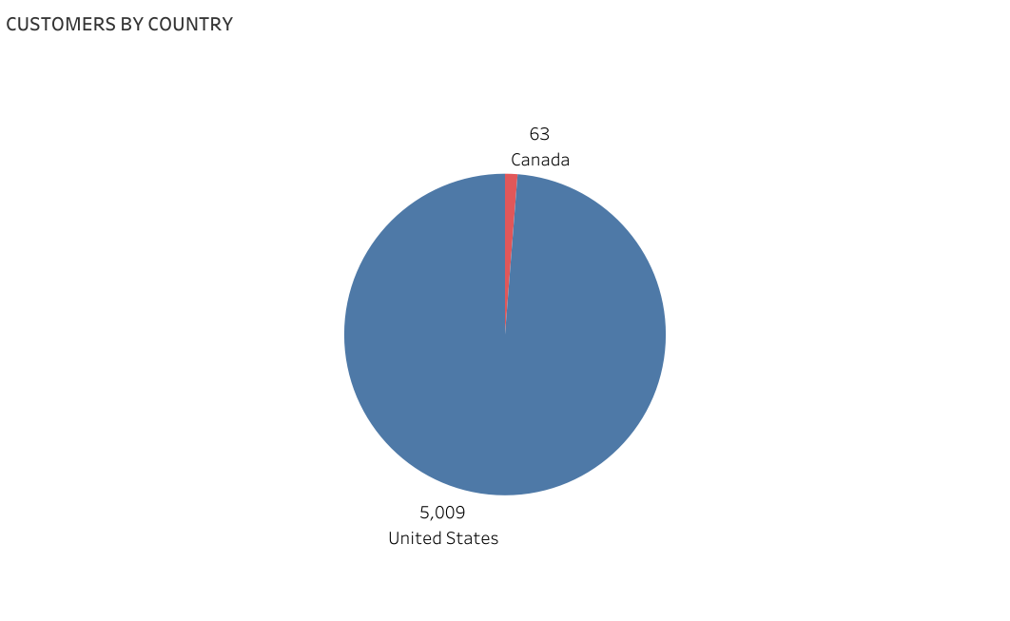
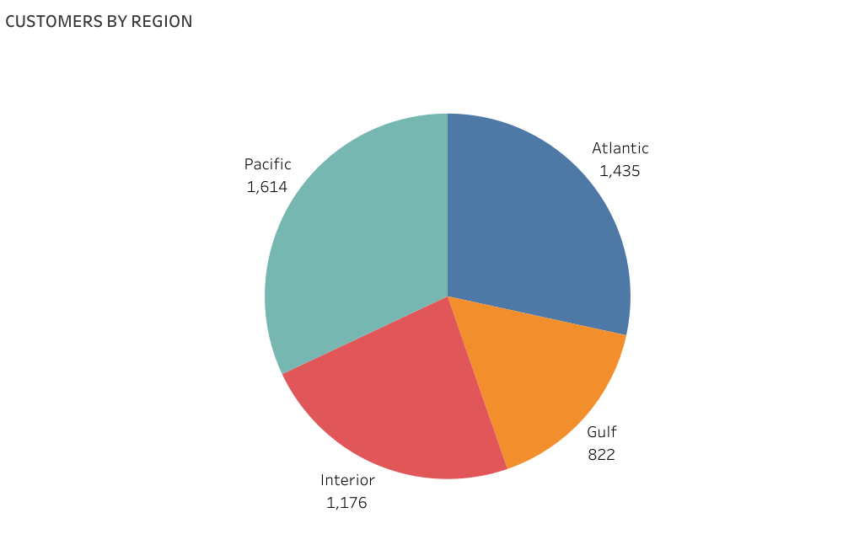
CUSTOMER DEMOGRAPHIC
The pie charts made divide the distinct customer IDs by countries and the regions.
The company sells candies in two countries, USA and Canada. They have around 5000 customers in USA and around 63 in Canada.
Most of the customers reside in the Pacific region followed by Atlantic.

Slide 5
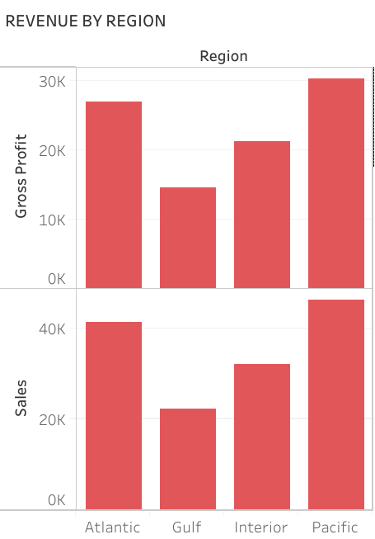
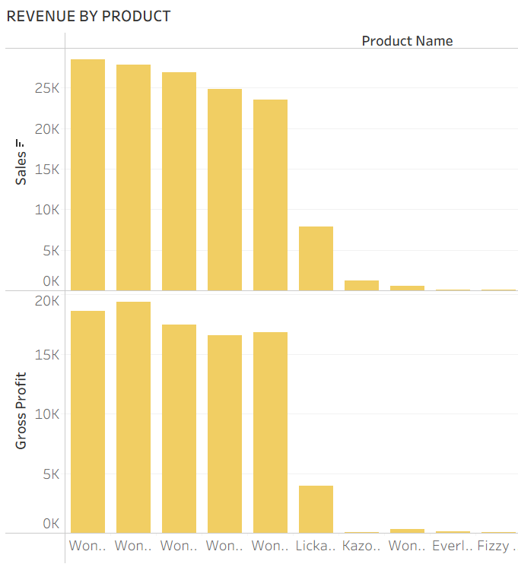
REVENUE BY REGION AND PRODUCT
1) The most revenue is collected from the Pacific region. It is also the most profitable region. Since the greatest number of clients are from Pacific, this seems accurate.
2) The next chart shows revenue and profit by product. All the Wonka chocolate bars are the highest selling products. Triple Dazzle Caramel is the most sold but it generates less profit than the second most sold chocolate, Scrumdiddlyumptious. Only the Wonka gum isn’t sold as much.
Fun dip and Nerds have made a profit of $12 together in the 4-year span.

Slide 6
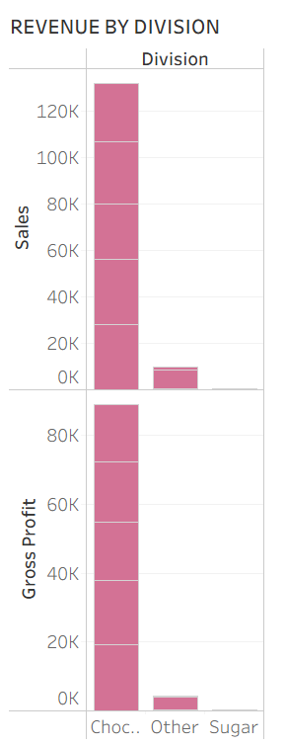
REVENUE BY DIVISION
The highest selling products were the Wonka bars so chocolate being the most revenue generating product is no surprise. The other products and sugar are not doing well. It is recommended that they highly advertise these products for an increase in sales.

Slide 7
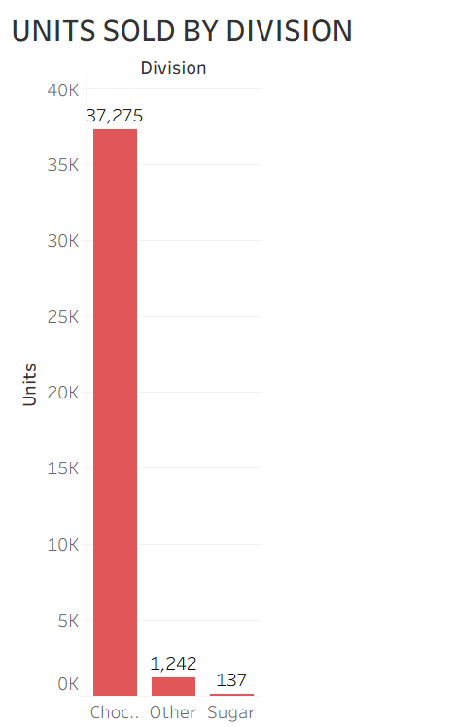
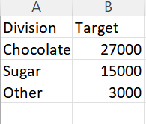
Company target
The company’s target for units sold can be seen in the picture next to this. Comparing this to the bar graph of units sold by division, it is observed that they have achieved their chocolate target by a milestone but the sugar and the other targets are yet to be reached. In fact, they are far off from their targets. We also noticed that for these 2 divisions sales were very low. If the business wants to reach their target, they will need heavy funding for advertisement, production and distribution.

Slide 8
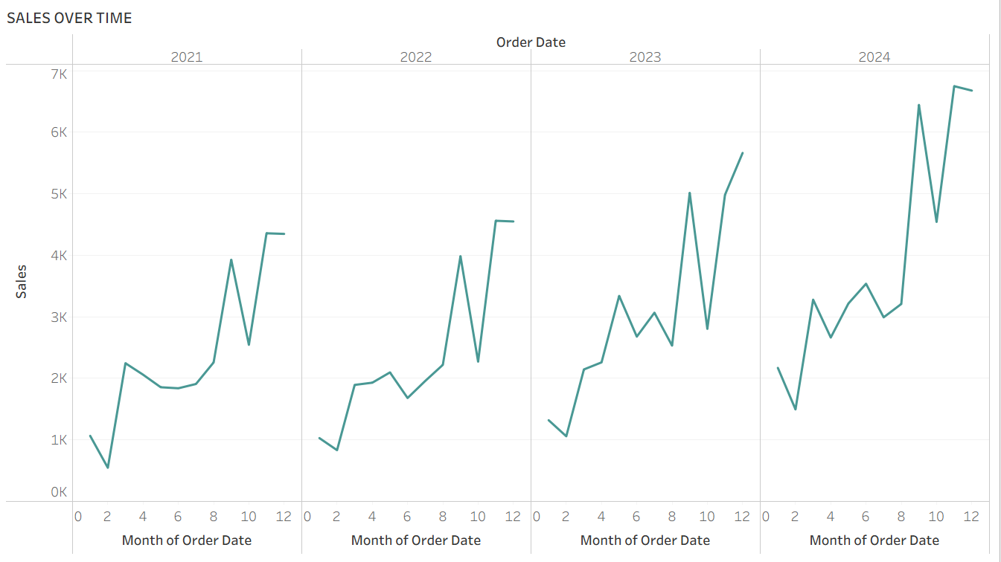
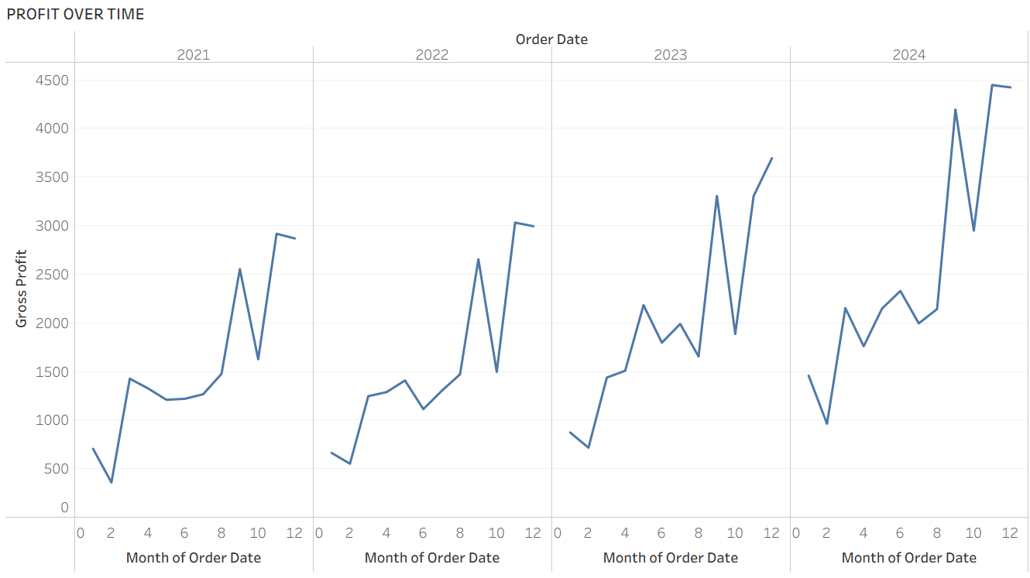
SALES AND PROFIT OVER TIME
The company sales and profit seem to increase over the time. Over the years, they have maximized their sales and profits, which is a good sign. Every year the sales and profit seem to drop for October, this drop has been consistent. I would advice the company to make more Halloween themed candy for October to prevent this drop and to keep the revenue steady.

Slide 9
Innovative solutions
1. The company experiences a drop in the sales every year in the month of October. To keep the sales consistently increasing, they need to be innovative about the candies sold in this month. They can sell Halloween specialized candies to generate more revenue. People buy tons of candies in US and Canada during that time. This is a huge opportunity waiting for them and they must use it for their advantage.
2. Triple Dazzle Caramel is the most sold chocolate but it generates less profit than the second most sold chocolate, Scrumdiddlyumptious. This must be looked into.
3. The company aims to achieve certain targets for sugar and other products. They are nowhere close to the target. This can be solved by market expansion and product innovation. Lots of time and hard work will be required to move closer to their aim.

Slide 10

Thank you
Original dataset
Tableau workbook
GitHub

